Slide 1
Reptile Theory in Insurance Coverage and Bad Faith Litigation
By Matt Ellison
FOWLER BELL PLLC
Lexington, KY
and
Pete Dworjanyn
COLLINS & LACY, PC
Columbia, SC

Slide 2
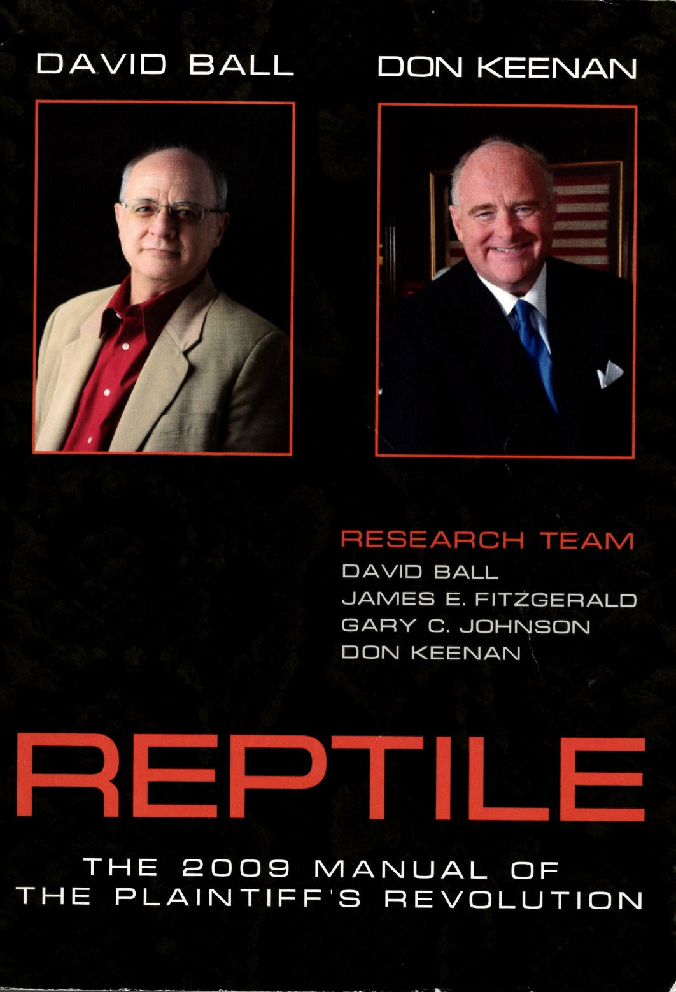

Slide 3
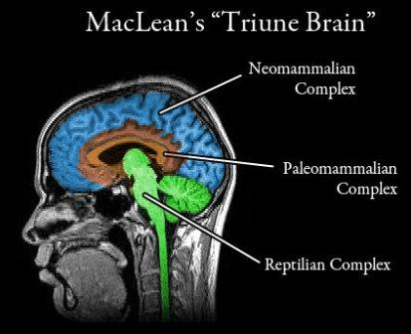
REPTILE The 2009 Manual of the Plaintiff’s Revolution

Slide 4
Table of Contents
ONE THE SCIENCE
TWO THE REPTILE SPEAKS
THREE THE TOXICOLOGY OF TORT – “REFORM”
(How They Hijacked the Reptile)
FOUR ANTIDOTE FOR TORT – “REFORM” POISON
(An Introduction to Danger)
FIVE WHAT DOES THE REPTILE MAKE US WANT?

Slide 5
SIX SAFETY RULES
SEVEN CODES(Know Your Audience)
EIGHT THE REPTILE AS LAW ENFORCER: HARMS AND LOSSES ONLY
NINE HYPOCRISY
TEN JURY SELECTION

Slide 6
ELEVEN OPENING FOR THE REPTILE
TWELVE EXPERT TESTIMONY
THIRTEEN CLOSING
FOURTEEN SCRIPTURE AND THE REPTILE
FIFTEEN CASE SELECTION

Slide 7
SIXTEEN MEDIATION AND THE REPTILE
SEVENTEEN CLIENT PREPARATION FOR DEPOSITION AND TRIAL TESTIMONY
EIGHTEEN THE REPTILE TAKES DEFENSE DEPOSITIONS
NINETEEN “SMALL” CASES
TWENTY STIPULATED CASES
TWENTY-ONE MEDICAL NEGLIGENCE CASES AND THE REPTILE

Slide 8
Chapter 1 The Science
When the Reptile sees a survival danger, even a small one, she protects her genes by impelling the juror to protect himself and his community.
Goal is to get juror’s brain out of fritter mode and into survival mode.

Slide 9
Chapter 3 Antidote for tort reform
1) How likely was it that the at or omission would hurt someone?
2) How much harm could it have caused?
3) How much harm could it have caused in other kinds of situations?
Show jurors the amount of potential harm.
Show possibility to meliorate by verdict, to serve as guardians of community.

Slide 10
Chapter Six Safety Rules
Never separate a rule from the danger it was designed to protect
1) Prevent Danger
2) Protect people in wide variety of situations
3) Be clear English, not legalese or technical
4) State what person must do-explicit
5) Be practical and easy to follow
6) One defendant has to agree with

Slide 11
Accident vs. Rule
Not accident
Defendant chose to violate a safety rule
Umbrella Rule: [Defendant] is not allowed to needlessly endanger public.
Case Specific Rules
Spreading tentacles of danger

Slide 12
7 Codes
Determine most common and fundamental connection with a concept, word, action, role, anything.
Good health: Mobility
Physician: Hero
Hospital: Processing plant
On Code or Off Code

Slide 13
18 Defense Depositions
Establish general safety rules
Relate general rules to specific safety rules
Show Reptile how this can happen to her
Safety First, Last, Always
Defendant did not care about safety
Defendant did not care about the person and does not care now

Slide 14
18 Defense Depositions
8) Did not have knowledge to safely do job
9) Expose defendant as a liar
10) Show defendant did not do his job
11) Show plaintiff did her job (patient, pedestrian, employee)

Slide 15
Did the insurer unreasonably act or fail to act in a manner that deprives the insured of the benefits of the policy?
Promptly and fairly investigate and evaluate claim
Look for coverage, disclose benefits and coverage that may apply, and give the insured’s interests the same regard as the insurer’s interests, or sacrifice insurer’s interests in favor of insured.
Communicate

Slide 16
Deposition preparation
Deposition is trial
Think about witnesses recorded by video
Re-think adage about answering only the question that has been asked, or about giving very short answers.
Prepare for their rules: All risk cannot be eliminated; each case is different; make own rule

Slide 17
COMMON THEME #1
The adjuster assigned to the claim failed to follow one or more provisions in the claim file.

Slide 18
“DIDN’T FOLLOW THE MANUAL”
GENERAL GOAL: To demonstrate that Insuramax’s representatives adjust claims without following the guidelines prepared for them.
“REPTILE” GOAL: The errors made in the adjustment of the plaintiff’s claim were entirely avoidable.

Slide 19
COMMON THEME #2
Insuramax denies the claim (first party) based upon strong circumstantial evidence that the insured caused the loss; but there is no smoking gun.

Slide 20
“SUSPICIOUS CIRCUMSTANCES”
GENERAL GOAL: Insuramax does not have a standardized rule or rules to determine when a loss is self-inflicted.
“REPTILE” GOAL: Because Insuramax has no standardized rule in the absence of a smoking gun for when a claim is fraudulent, it cannot be trusted to make correct decisions.

Slide 21
COMMON THEME #3
In a third-party claim where liability is clear but damages appear low, the adjuster responds to a high initial demand with a low counteroffer – lower than what the documentation suggests is fair.

Slide 22
“JUST AN OPENING OFFER”
GENERAL GOAL: To demonstrate that Insuramax has a habit of making offers on claims that it knows to be too low.
“REPTILE” GOAL: Because it engages in the practice of making low offers, Insuramax tries to take advantage of claimants who might “give up.”

